Slide 1

Stage – Développeur Politique de Sécurité
5th February – 26th July
Ramya Radjesh
EPITA – Fall 2022– Computer Security

Slide 2
In this presentation…
01
02
03
04
Orange
eBPF
eBPF – Intern Objective
Internship -Deliverable 1
05
06
07
Internship
-Deliverable 2
Replication - BPFroid
Conclusion & Questions
Notes:
French

Slide 3

01
01
Orange
Units
Units
Orange Innovation
Emerging Technologies
Innovation Ecosystem
Product Development
Founded: January 1, 1988, originally as French Telecom S.A.
Industry: Telecommunications and Digital Services
Global Presence: Operates across Europe, Africa, and the Middle East
Core Business: Focus on excellence in telecom services (5G, Fiber, IoT)
Current Goal: “Lead the Future”
Orange Cyberdefense
Managed Security Services
Hreat Intelligence
Security Consulting

Slide 4


02
eBPF & BPF
02
“eBPF is a revolutionary technology with origins in the Linux kernel that can run sandboxed programs in a privileged context such as the operating system kernel. It is used to safely and efficiently extend the capabilities of the kernel without requiring to change kernel source code or load kernel modules.”
“BPF programs are primarily used for packet inspection, offering significant performance enhancements. Those programs are used for packet inspection, offering significant performance enhancements. It manages packet copying from kernel to user space, using an interpreter and JIT compiler.”

Slide 5
03
03
eBPF – Internship objective
Technical Research papers
Mitigation of Mobile Security Related vulnerabilites
eBPF
Collecting Inforamtion
About eBPF
Articles & Blogs
Replicating eBPF based security framework to understand its capabilites
Finding eBPF compatible mobile Environment
BPFroid
Mobile OS

Slide 6











Deliverable 1
04
04
eBPF Compatible Mobile Environment

Slide 7
04
Deliverable 1 – Criteria Consideration
04
Operating System Functionalities
Kernel Layer Functionality
Architecture
Potential eBPF Usecase
Evidence of eBPF usage
Future possibility of eBPF
For every OS I researched about their,
eBPF in Android
Network usage monitoring
Power and memory profiling
Firewall, Intrusion detection
Kernel security monitoring.

Slide 8

Deliverable 2
05
05
State of art in eBPF applied to Mobile Security
Mobile Security
Android Security
eBPF
eBPF Components and their functions
eBPF + Mobile Security research paper
Classification & Commonalities among research paper (eBPF)

Slide 9
Commonalities 1: eBPF Maps
Key value Storage and Attack Mitigation
Commonality 2:ProgramVerification
Verifier types and Additional Security
All the commonalities that are identified abide with eBPF functions and their difference in functionalities and upgradation with the timeline
¸
Commonality 3: Syscall
syscall operation for monitoring and Seccomp operation
Commonality4: Nativecode Executionand Protection
Target Environment, Security Mechanism and policy
Commonality 5: Userspace Operations

Slide 10
06
06
Replication - BPFroid
BPFroid is a detection framework of a malware.
BPFroid uses eBPF technology to monitor user application events in real device.
It hooks these events into the kernel, preventing malware from bypassing monitoring.
BPFroid follows hooking mechanism and does robust hooking mechanism inside Linux kernel.
BPFroid traces all layer to keep in track of malware detection.
Layers:
          API method invocation
          Native librairies function calls
          Direct system call
          Internal kernel function calls
Tracee:
BPFroid is build upon Tracee.
Developers expanded the tracee’s capabilities to support ARM64 devices and added Uprobes support so we can trace android native library and android framework API calls.

Slide 11
What BPFroid does?
BPF based monitoring:
BPFroid uses BPF Linux technology.
BPFroid traces events of Android framework API calls, native libraries functions calls, system calls and internal kernel functions.
Robust Malware detection:
BPFroid method leverages a linux kernel tracing mechanism without tampering with the system images, the application packages or the kernel.
BPFroid uses hooking mechanism, which happens inside a VM in the kernel, so it is robust and can run safely on the real devices.
eBPF based dynamic behavioural signatures:
BPFroid detect suspicious behaviours and captures forencis artifacts.

Slide 12
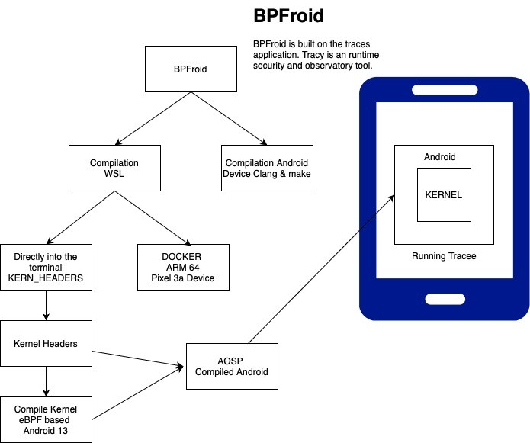
BPFroid Flow Diagram and Versions
Android Version: 13
Linux Kernel Version: 5.10
Platforms Used:
WSL & Android Studio
In BPFroid replication process upon deploying tracee, I was able to see all the syscall, few API functions, UPROBES & KPROBES operations.

Slide 13
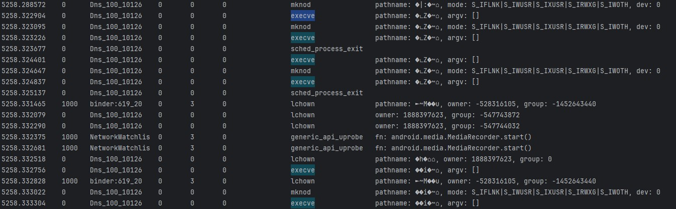
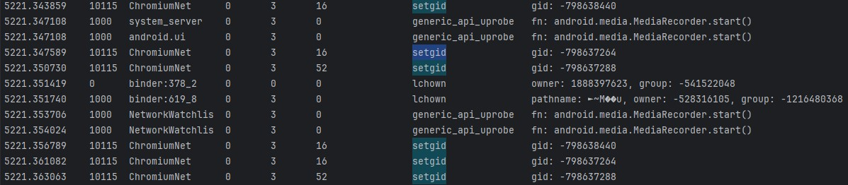
Result:
Monitor operations : System call, Uprobes, Kprobes, API
Syscall – execve & mknod
Kprobe – sched_process_exit
Syscall – Open & lchown
Syscall – setgid
Uprobe – generic_api_uprobes

Slide 14
07
07
Conclusion
“Enhanced my knowledge towards eBPF and Mobile Security”
Professional Milestone and Personal Growth:
Orange
Improved my skills in both research analysis & Addressing issues with Delpoyment.
Deeply understand about eBPF and its security features.Global idea of how android and eBPF works.
Experience with french based environment and improved my french skills.
A special thanks to my mentor NICOLAS. Grateful to be part of orange innovation and par tof data privacy team.
Cybersecurity Curriculum:
EPITA
Backbone of my cybersecurity journey
Subjects like Linux for Security, Data privacy by design helped with the internship subject.
Thankful to EPITA for providing a transformative learning environment.
A special thanks to my professors.

Slide 15
Thank You

